Slide 1
Sequence to Sequence Learning
Jack Koch
CPSC 677

Slide 2
Introduction
Many ML tasks expressible as sequence transduction tasks—the transformation of input sequences to output sequences
Transliteration
Spelling Correction
Inflectional Morphology
Machine Translation
Speech Recognition
Protein Secondary Structure Prediction
Text-to-Speech
Semantic Parsing
More information about sequence transduction available here
Sequence-to-sequence models are a class of neural models useful for sequence transduction tasks
Notes:
“Seq2seq models are extremely effective on a variety of tasks that require a mapping between a variable-length input sequence to a variable-length output sequence.” (Ramachandran et al.)

Slide 3

Encoder-Decoder Architectures
Encoder-decoder structure - used by most competitive neural sequence transduction models
Encoder maps an input sequence of symbol representations to a sequence of continuous representations
Given z, the decoder then generates an output sequence of symbols one element at a time
Auto-regressive at each step
https://jalammar.github.io/illustrated-transformer/
Notes:
Auto-regressive at each step, consuming the previously generated symbols as an additional input when generating the next.

Slide 4
Papers Covered
3 SOTA-setting NMT papers
Sequence to Sequence Learning with Neural Networks
Ilya Sutskever, Oriol Vinyals, Quoc V. Le, NIPS 2014
Unsupervised Pretraining for Sequence to Sequence Learning
Prajit Ramachandran, Peter J. Liu, Quoc V. Le, EMNLP 2017
Attention is All You Need
Ashish Vaswani, Noam Shazeer, Niki Parmar Jakob Uszkoreit, Llion Jones, Aidan N. Gomez, Lukasz Kaiser, Illia Polosukhin, NIPS 2017

Slide 5
WMT Dataset
The academic benchmark for machine translation
Most benchmark NMT papers (and all three covered today) use WMT 2014 training dataset on En-Fr and/or En-De translation tasks
WMT 2015 benchmark does exist but is less frequently used
~4 million sentence pairs for En-De, ~12M for En-Fr

Slide 6
BLEU Metric
Bilingual Evaluation Understudy
Proposed by Papni et al., 2002
Idea: compare n-grams of the candidate with the n-grams of the reference translation and count the number of matches
Matches are position independent
More matches, better the candidate translation
Ranges from 0 to 1, but results presented here (and in NMT in general) are scaled by a factor of 100
Few translations will attain a score of 1 unless identical to a reference translation
Even a human translator will almost definitely not score 1
On a test corpus of about 500 sentences (40 general news stories), a human translator scored 0.3468 against four references and scored 0.2571 against two references
See original paper for math, most of the time you can find a function or library to do it for you

Slide 7
Paper 1: Sequence to Sequence Learning with Neural Networks
Ilya Sutskever, Oriol Vinyals, Quoc V. Le, NIPS 2014
Goal: “present a general end-to-end approach to sequence learning that makes minimal assumptions on the sequence structure”
Utilize a multilayered LSTM to map input sequence to a vector, then another deep LSTM to decode the target sequence from the vector

Slide 8
The Difficulty with DNNs on Sequential Data
DNNs had already proven to be extremely powerful machine learning tools at the time of this paper in fields, CV and speech
Sequences are challenging for DNNs
Dimensionality of inputs and outputs must be known and fixed for DNNs
Many important problems (speech recognition, machine translation, etc.) are best expressed with sequences of arbitrary length
Previous work in NMT had successes with using LSTM networks to rescore hypotheses from an SMT system
However, no purely neural model had beaten a phrase-based SMT baseline

Slide 9
The Idea
Use one LSTM to read the input sequence one time-step at a time -> obtain large fixed-dimensional vector representation
Use another LSTM to extract the output sequence from that vector
This is essentially an RNN language model but conditioned on the input sequence
Why LSTM?
Ability to learn on data with long range temporal dependencies

Slide 10
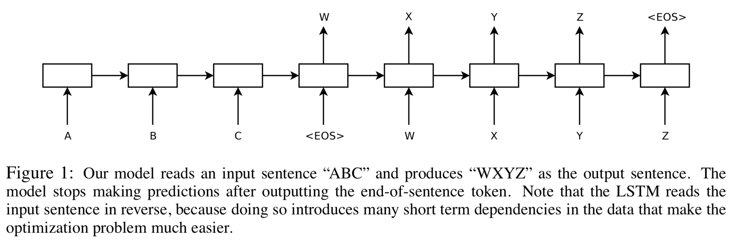
The Model
Image: Fig.1, Sequence to Sequence Learning with Neural Networks

Slide 11
Miscellaneous Details
Use simple left-to-right beam search to find most likely translation
Source sentences are fed into the encoder in reverse

Slide 12
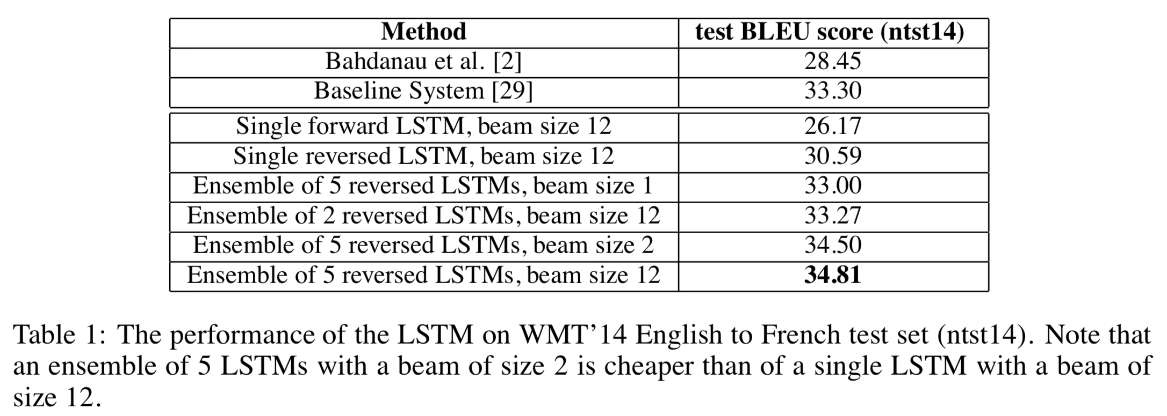
Results
Image: Table 1, Sequence to Sequence Learning with Neural Networks
Notes:
Best results obtained using an ensemble
Different random initializations and random order of minibatches
“First time that a pure neural translation system outperforms a phrase-based SMT baseline on a large scale MT task by a sizeable margin, despite its inability to handle out-of-vocabulary words.”

Slide 13
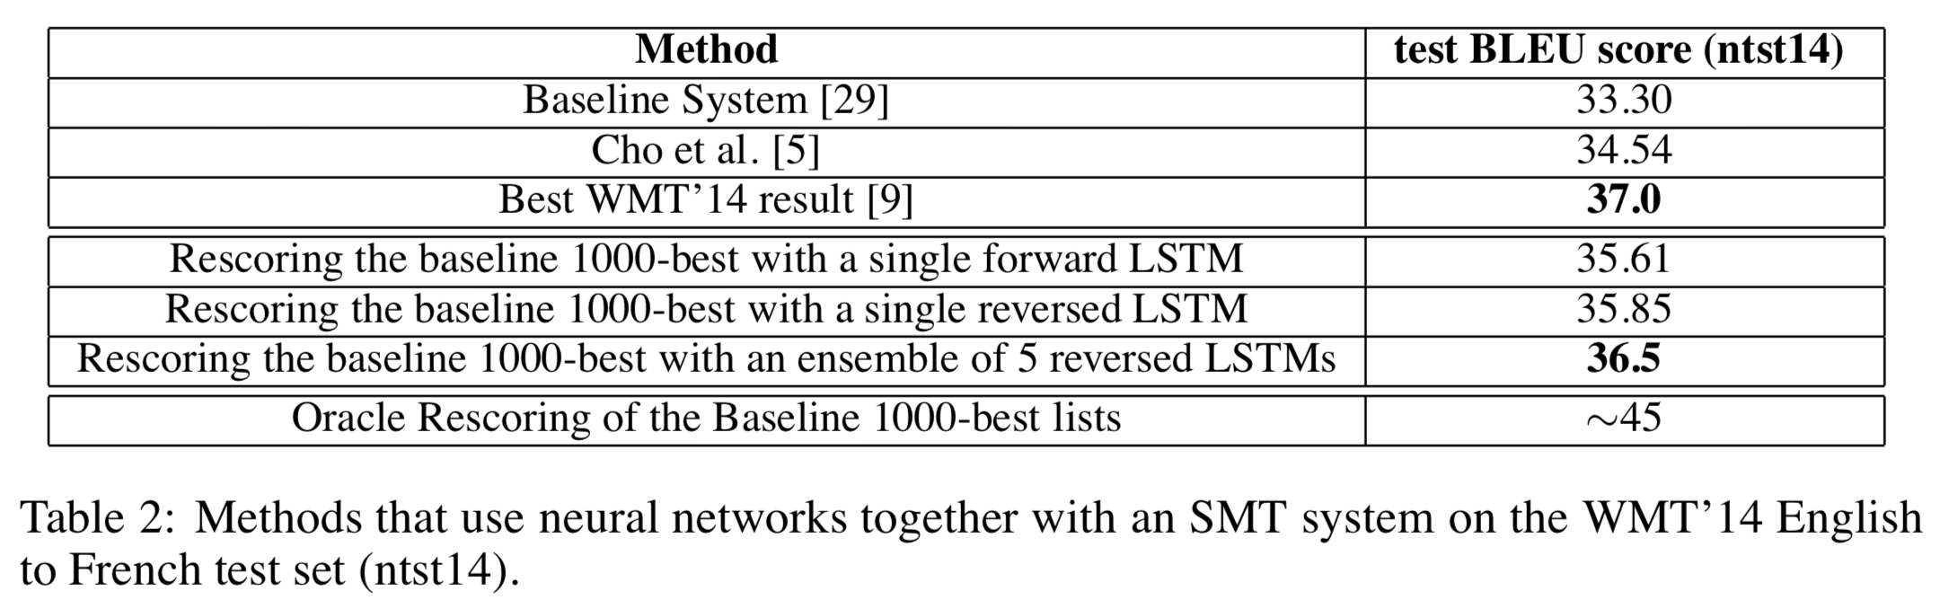
Results
Image: Table 2, Sequence to Sequence Learning with Neural Networks
Notes:
Within 0.5 BLEU points of the best WMT 14 results if it is used to rescore the 1000-best list of the baseline system

Slide 14
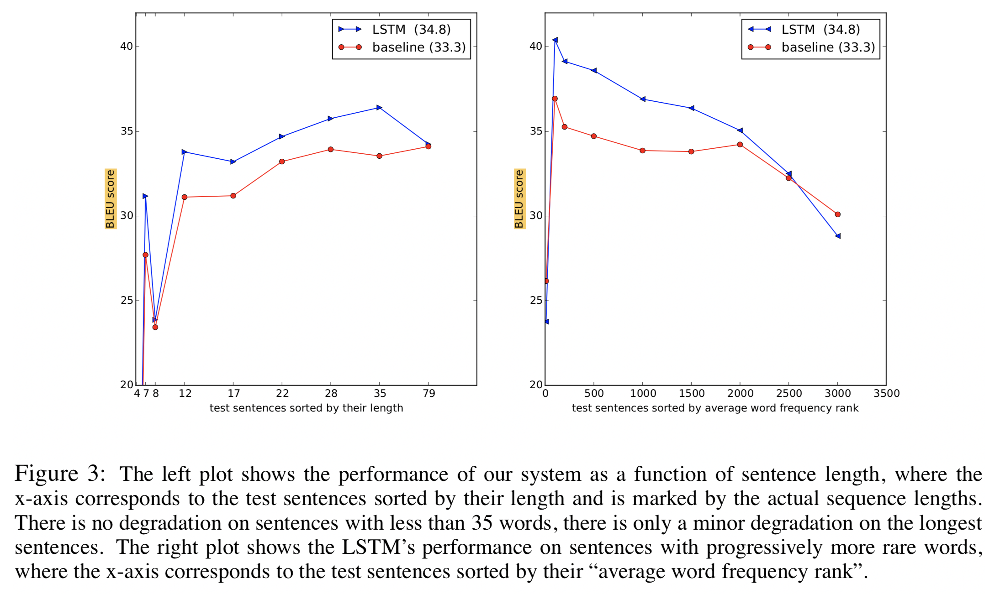
Performance on Long Sentences
Image: Fig.3, Sequence to Sequence Learning with Neural Networks
Notes:
Performs well on long sentences - a problem that plagued early attempts at applying similar neural architectures to NMT

Slide 15
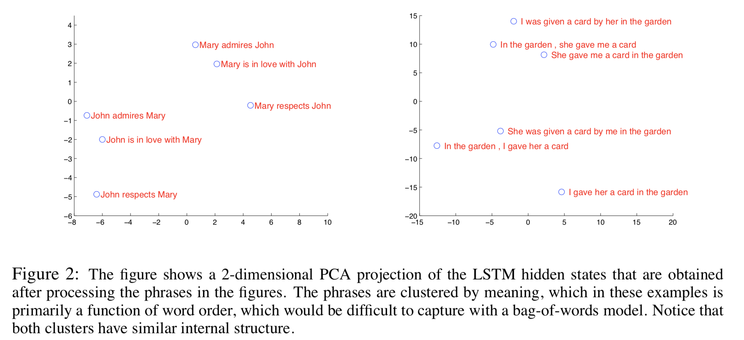
Analysis
Image: Fig.2, Sequence to Sequence Learning with Neural Networks
Notes:
Model has ability to turn a sequence of words into a vector of fixed dimensionality
Representations are sensitive to order of words
Fairly insensitive to the replacement of active voice w/ passive voice
-> clustered by meaning

Slide 16
Paper 1 Discussion
Why do you think the source sentences were fed in reverse?
Can you think of any other domains where a seq2seq model might be applicable?
Can you think of any improvements that might be made to this model?

Slide 17
Paper 2: Unsupervised Pretraining for Sequence to Sequence Learning
Prajit Ramachandran, Peter J. Liu, Quoc V. Le, EMNLP 2017
Goal: initialize the weights of the encoder and decoder of a seq2seq model with the pretrained weights of two language models in order to fine-tune the model on labeled data
Apply this method to benchmarks in machine translation and abstractive summarization

Slide 18
Unsupervised Pretraining & Supervised Finetuning
Motivation: seq2seq models (and deep networks in general) can easily overfit when the amount of supervised training data is small
Solution: use unsupervised pretraining to improve seq2seq models
Use pretrained weights from language models to initialize model and finetune on the new domain with labeled data
Unsupervised pretraining with language models & supervised finetuning are also the main motivation for other recent language understanding models: ULMFiT, ELMo, OpenAI Transformer, and BERT
NLP’s ImageNet Moment (Ruder)

Slide 19
Basic Procedure
Pretrain both seq2seq encoder and decoder networks with language models
Collect two monolingual datasets - one for source language, one for target language
Here, News Crawl English and German corpora, both >1B tokens
Train a language model on each dataset independently
Initialize seq2seq model with LM weights
Construct multilayer seq2seq model
Embedding & first LSTM layers of encoder and decoder are initialized with pretrained weights
Softmax of decoder is initialized with the softmax of the pretrained target side LM
Finetune on labeled data
Notes:
Observation: without the encoder, the decoder essentially acts like a language model for the target language
With an additional output layer, the encoder also acts like a language model for the source language
Pretrain both seq2seq encoder and decoder networks with language models (which can be trained on large amounts of unlabeled text data)

Slide 20
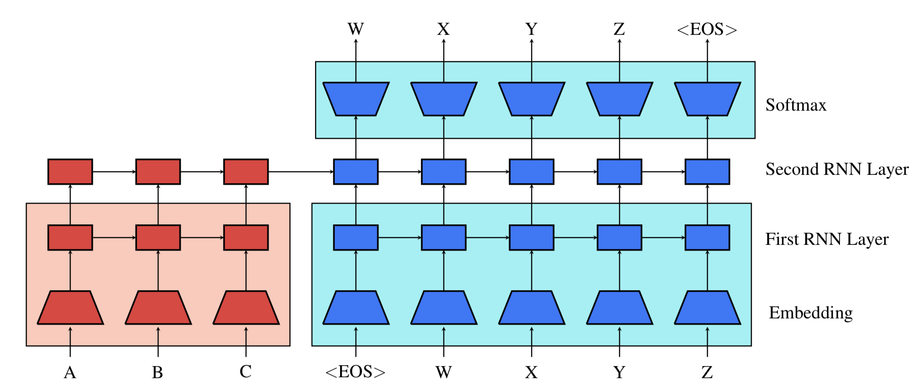
Model
Image: Fig.1, Unsupervised Pretraining for Sequence to Sequence Learning
Notes:
Red parameters are the encoder
Blue parameters are the decoder
All parameters in a shaded box are pretrained - either source side (light red) or target side (light blue) language model

Slide 21
The Problem of Catastrophic Forgetting
Overly aggressive finetuning will cause catastrophic forgetting and the network will destroy too much of the information it has learned from language modeling
Overly cautious finetuning will cause slow convergence and overfitting
Solution: include language modeling as an auxiliary objective
Weight language model loss and seq2seq loss equally for total loss

Slide 22
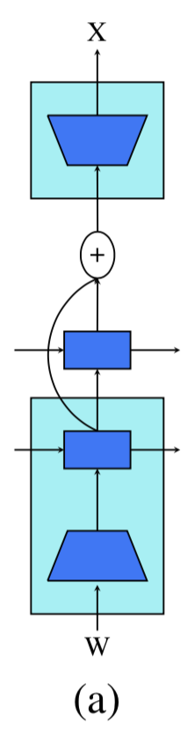
Other improvements: Residual Connections
Problem: the input vector to the decoder softmax layer is a random vector (since top layer of LSTM is randomly initialized)
Introduces random gradients to pretrained parameters
Solution: use a residual connection from the first LSTM layer directly to the input of the softmax
Image: Fig.2a, Unsupervised Pretraining for Sequence to Sequence Learning

Slide 23
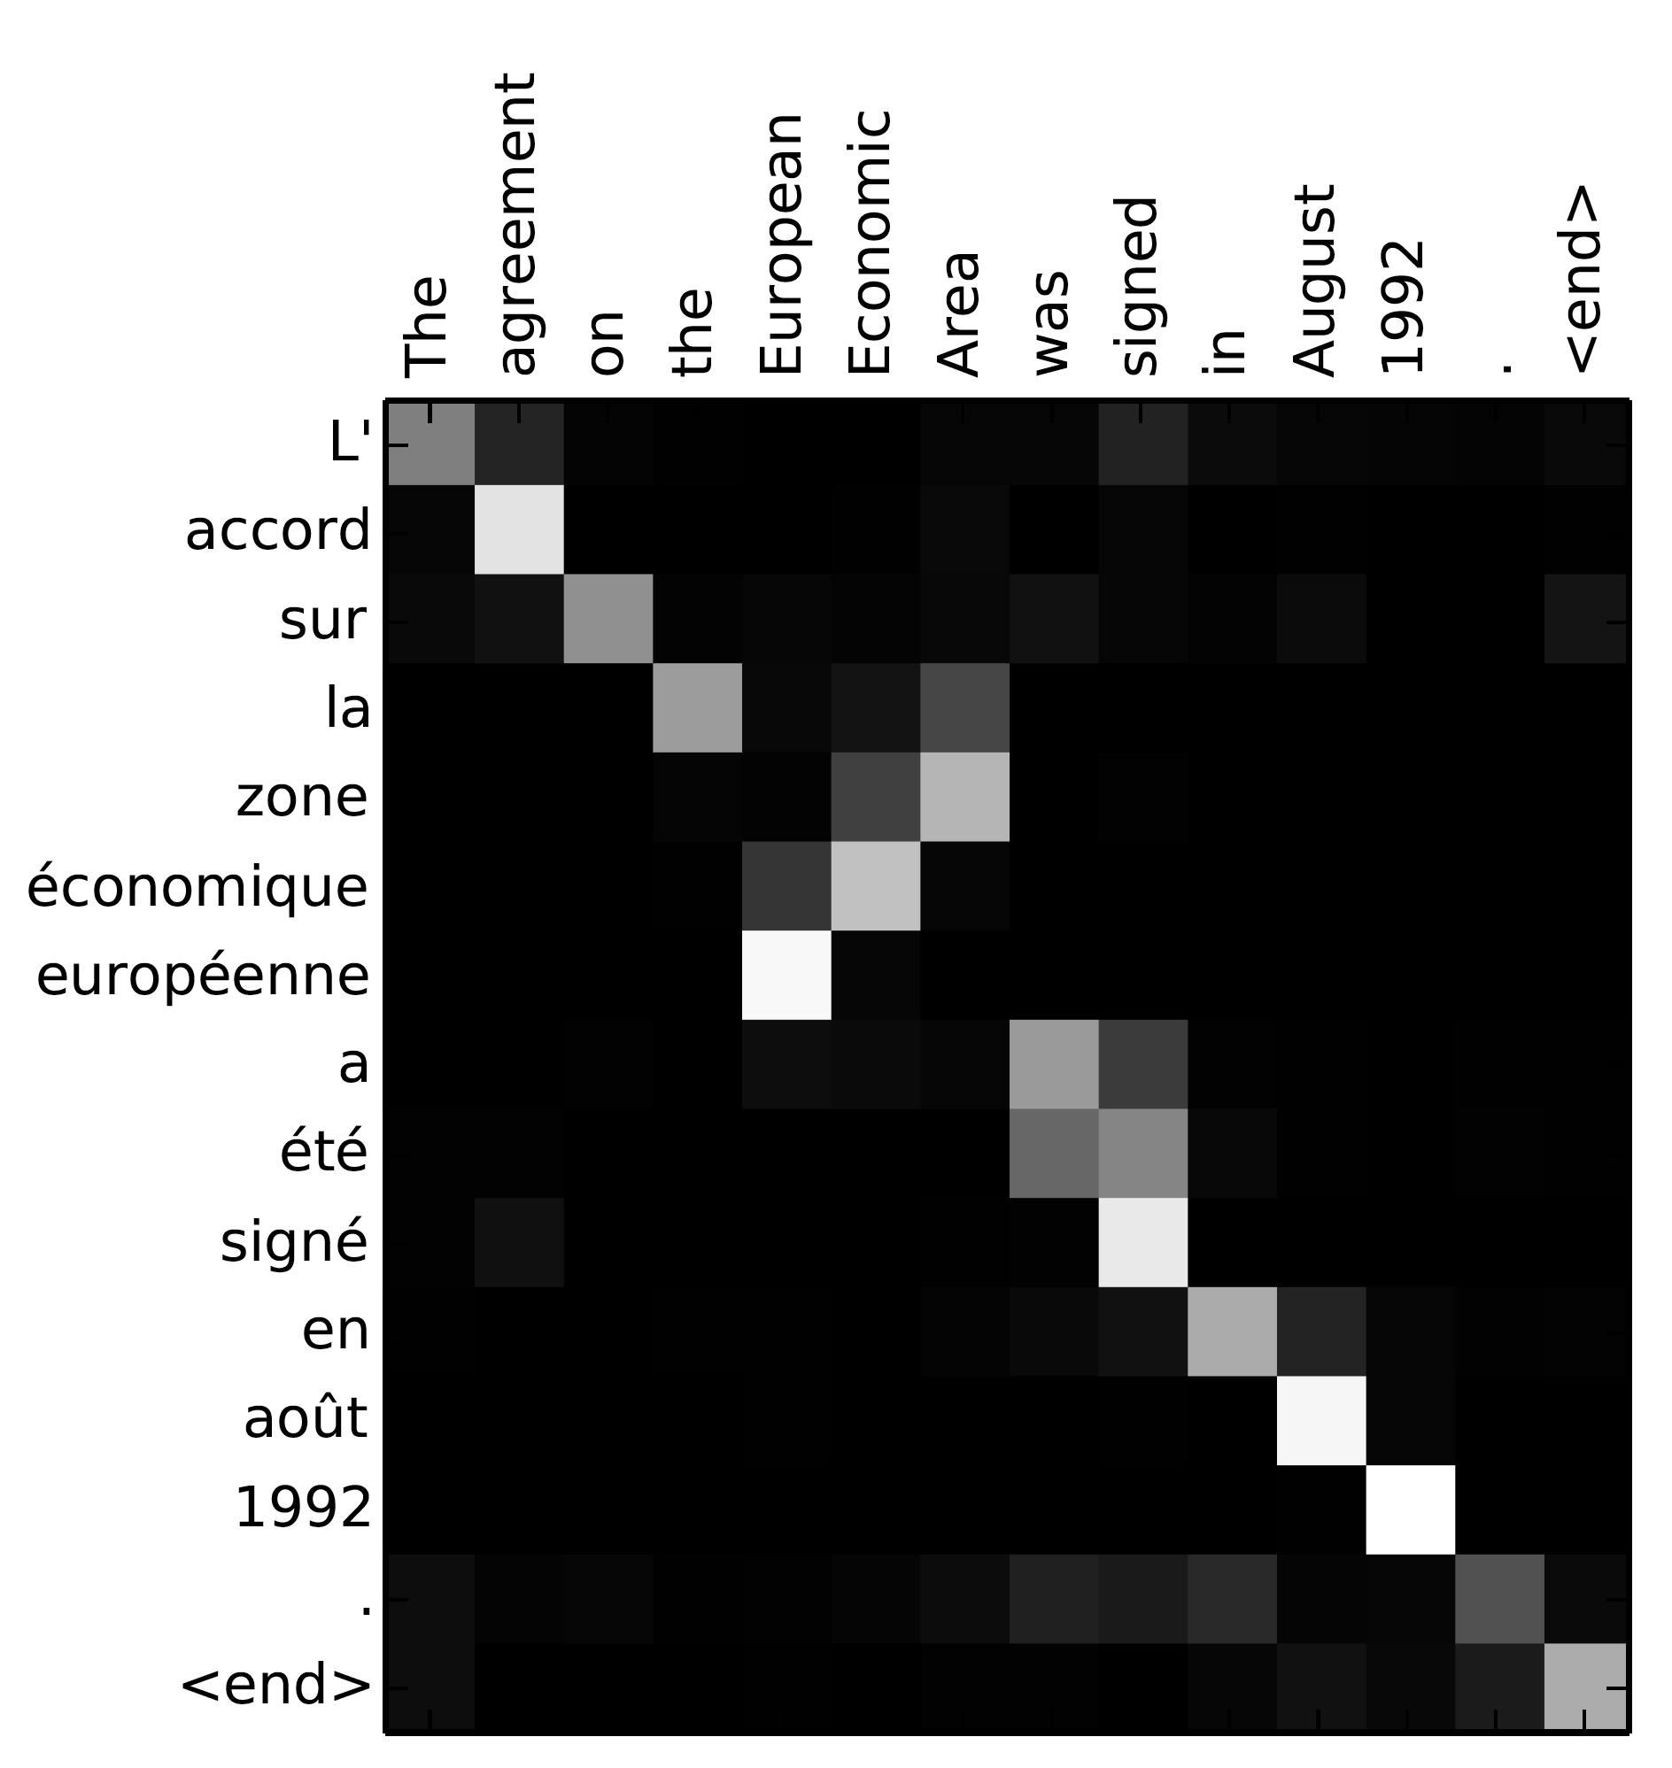
Background: Seq2Seq w/ Attention
Attention mechanism: first introduced by Bahdanau et al., 2015, refined by Luong et al., 2015
Luong paper was the first purely neural model to achieve SOTA in NMT
Today, you almost never see “vanilla” seq2seq model—always seq2seq w/ attention
Key idea: establish direct shortcut between target and source by paying “attention” to relevant source content as we translate - what parts of the input are relevant to determining the next output?
Nice byproduct: easy-to-visualize alignment matrix between the source and target sentences
Image: Bahdanau et al., 2015

Slide 24
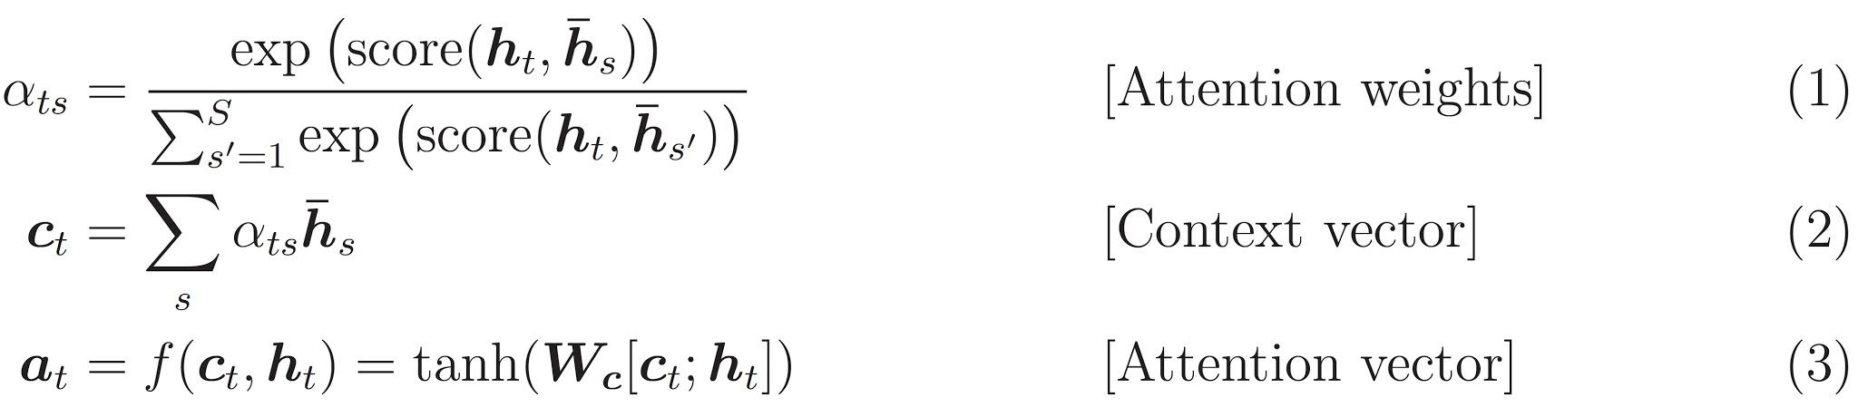
Background: Attention Mechanism
Current target hidden state compared w/ all source hidden states to derive attention weights
Based on attention weights, compute context vector as weighted average of source states
Combine context vector w/ current target hidden state to yield final attention vector
Attention vector is fed as an input to the next time step (input feeding)
Image: Source
Notes:
Here, the function score is used to compare the target hidden state $$h_t$$ with each of the source hidden states $$\overline{h}_s$$

Slide 25
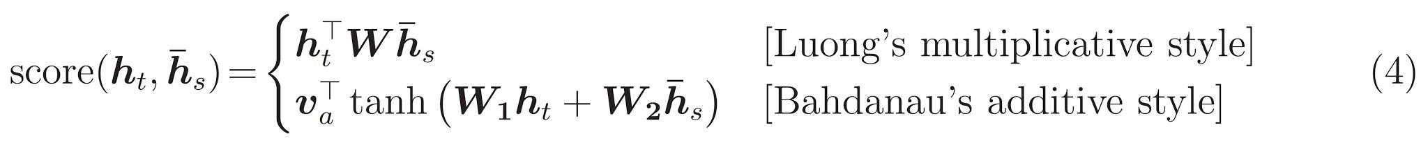
Background: Score Function
Image: Source
Notes:
Various choices for scoring function - multiplicative and additive are most popular

Slide 26
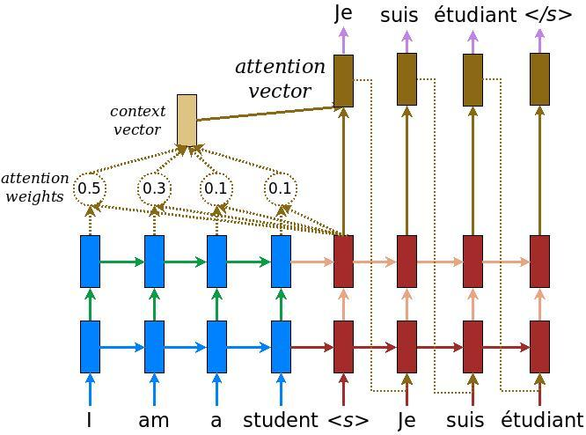
Background: Seq2Seq w/ Attention
Image: Luong et al., 2015
Notes:
Luong et al., 2015 was the first purely neural translation system to set SOTA

Slide 27
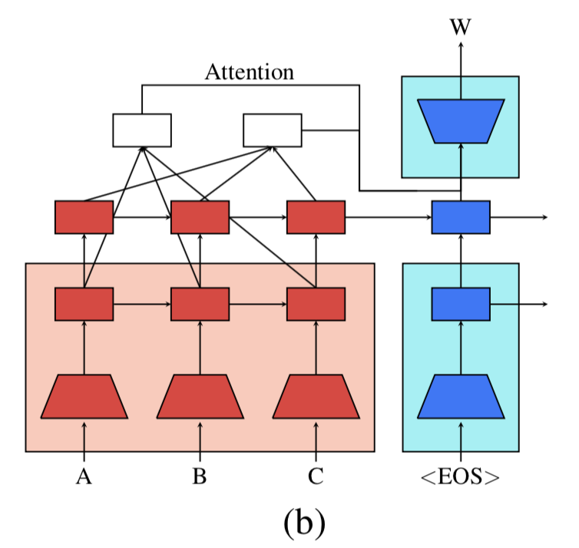
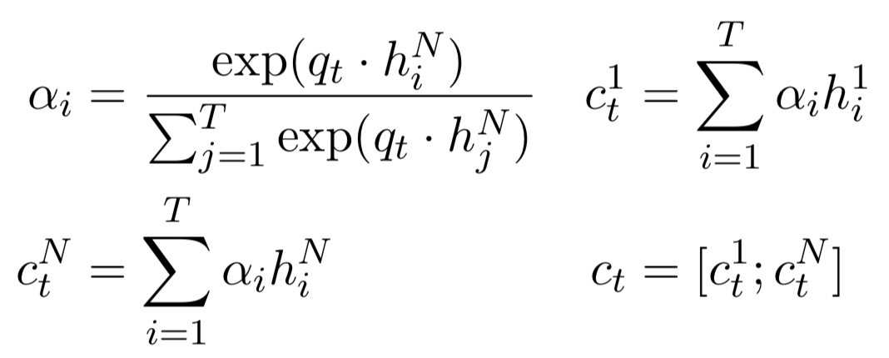
Other improvements: Multi-layer Attention
Idea: use an attention mechanism where model attends over both top (translation) and first (pretrained) layer
Given a query vector q_{t} from the decoder, encoder states from the first layer h₁¹,...,h_{T}¹, and encoder states from the last layer h₁^{L},...,h_{T}^{L}, compute attention context vector c_{t}:
Image: Fig.2b, Unsupervised Pretraining for Sequence to Sequence Learning

Slide 28
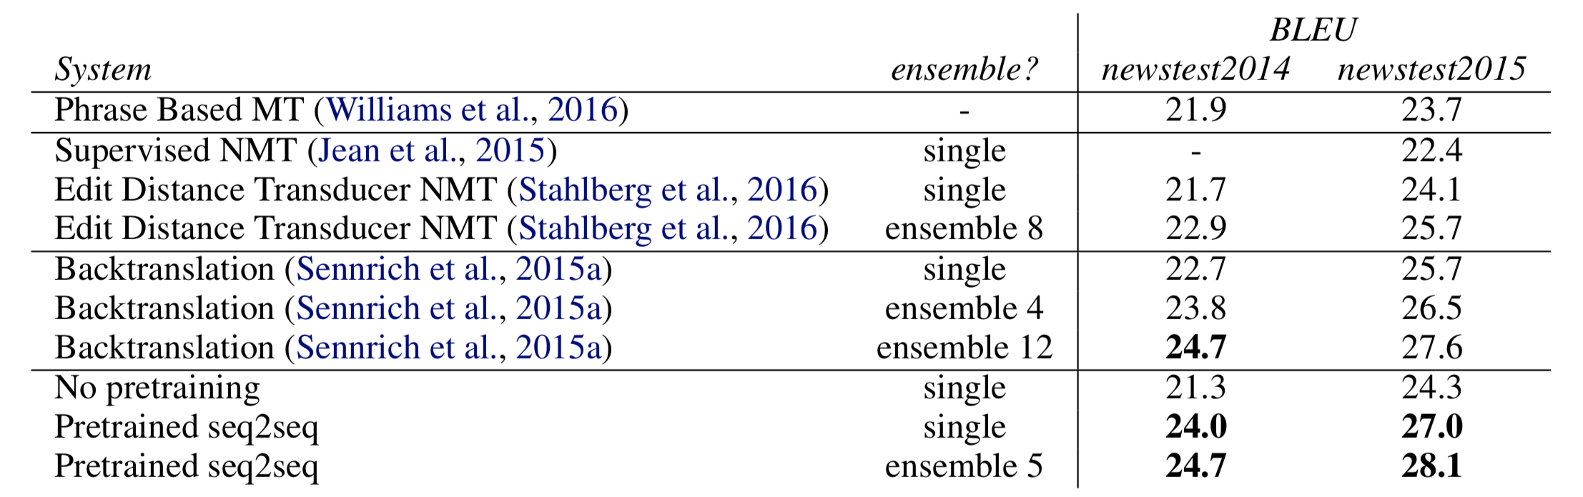
Results
Image: Table 1, Unsupervised Pretraining for Sequence to Sequence Learning
Notes:
En-De performance on WMT test sets. Note: model without pretraining uses the LM objective
New state of the art for single model performance on both newstest2014 and newstest2015
Best single model outperforms previous SOTA ensemble of 4 models
Ensemble of 5 models matches or exceeds the previous best ensemble of 12 models

Slide 29
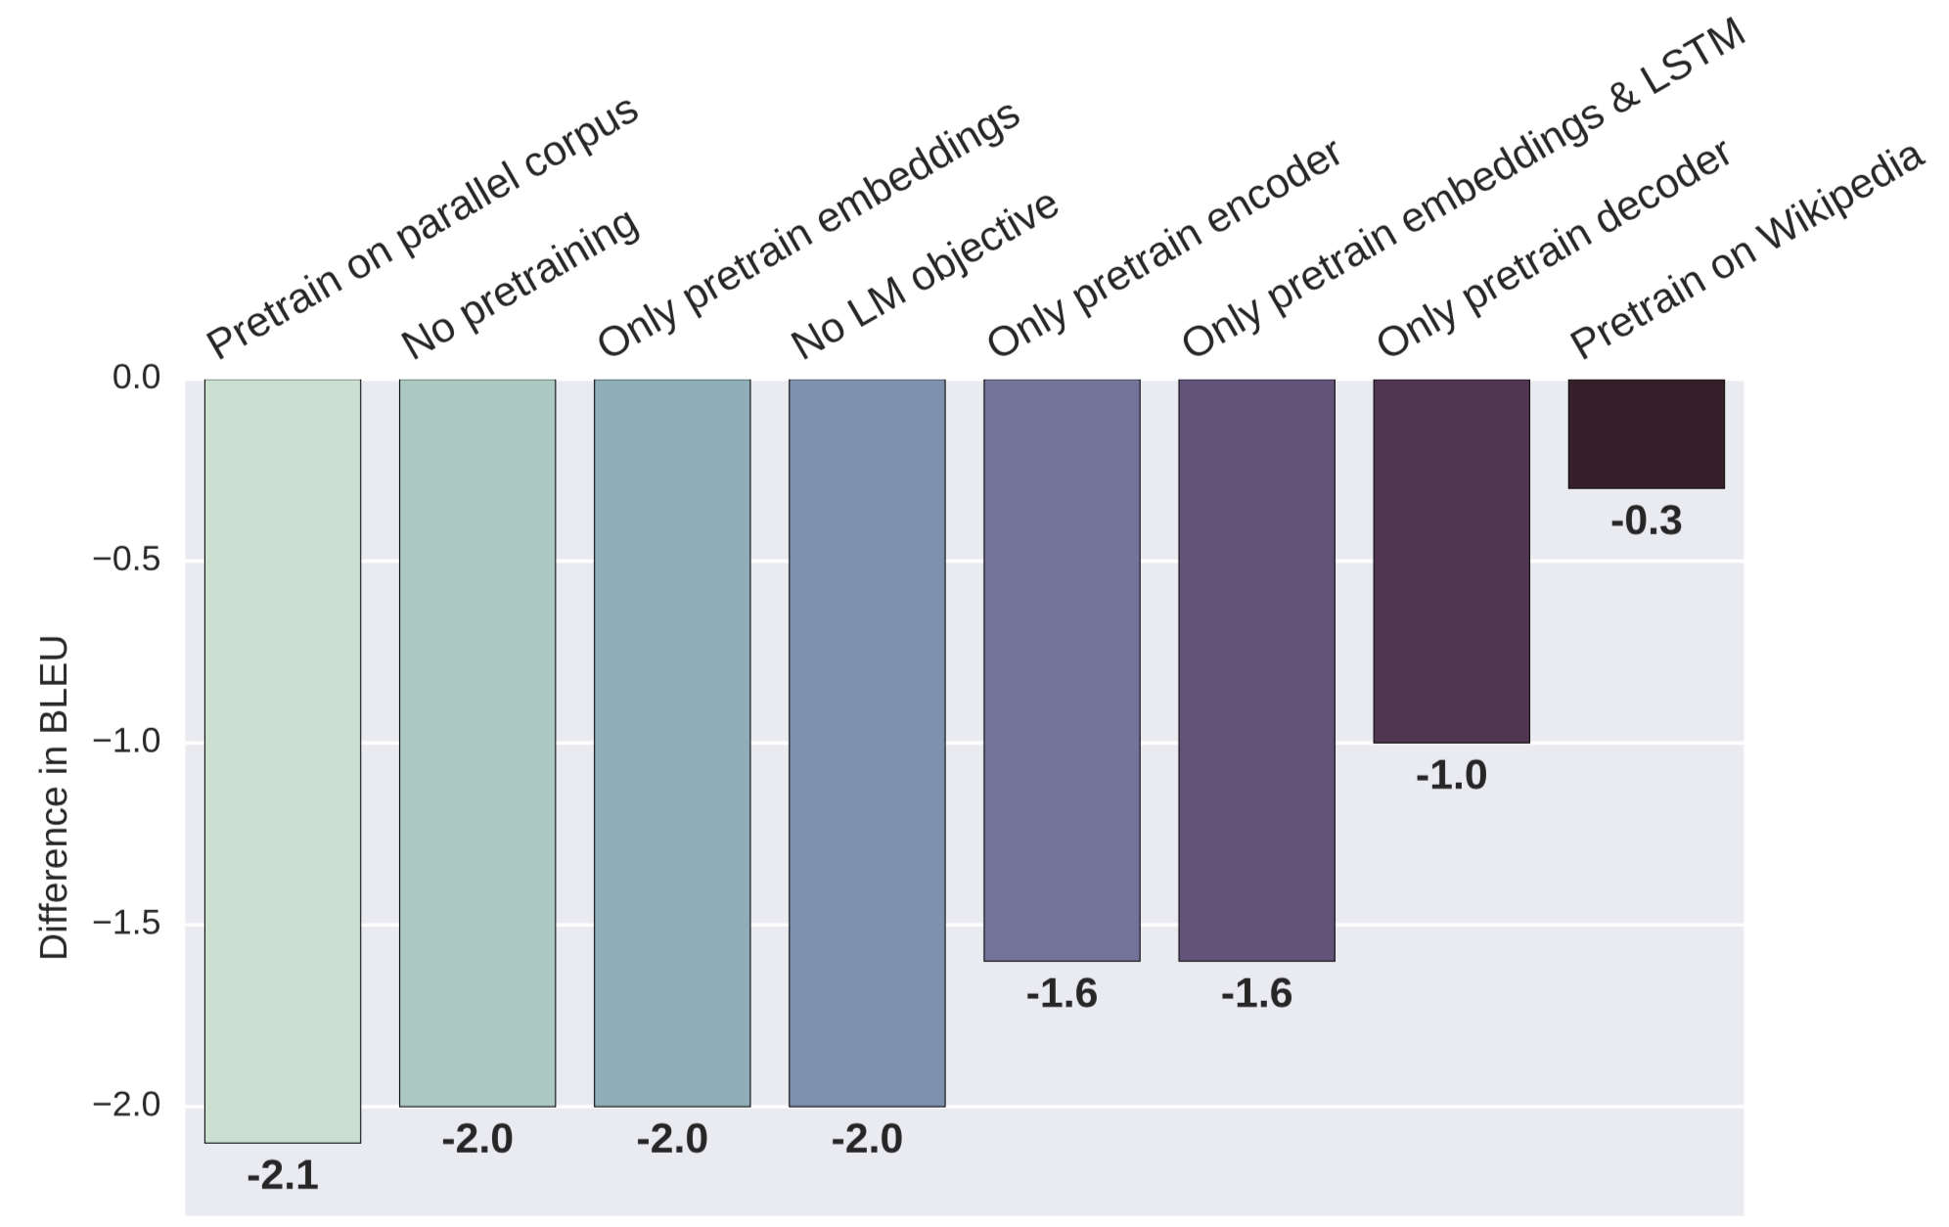
Ablation
Image: Fig.3, Unsupervised Pretraining for Sequence to Sequence Learning
Notes:
Measures difference in validation BLEU between various ablations and full model (more negative is worse)
Full model uses LMs trained with monolingual data to initialize the encoder and decoder, plus the language modeling objective
Only pretraining decoder > only pretraining encoder
Pretraining softmax is important (-1.6 BLEU if only pretrain embeddings and first LSTM layer)
Language modeling objective is strong regularizer
Drop in BLEU points of pretraining the entire model and not using the LM objective is as bad as using the LM objective without pretraining
Need to train on a lot of unlabeled data to extract powerful features
Model initialized with LMs pretrained on the source & target data of parallel corpus performs as poorly as not pretraining at all
Performance remains strong when pretrained on large, non-news Wikipedia corpus

Slide 30
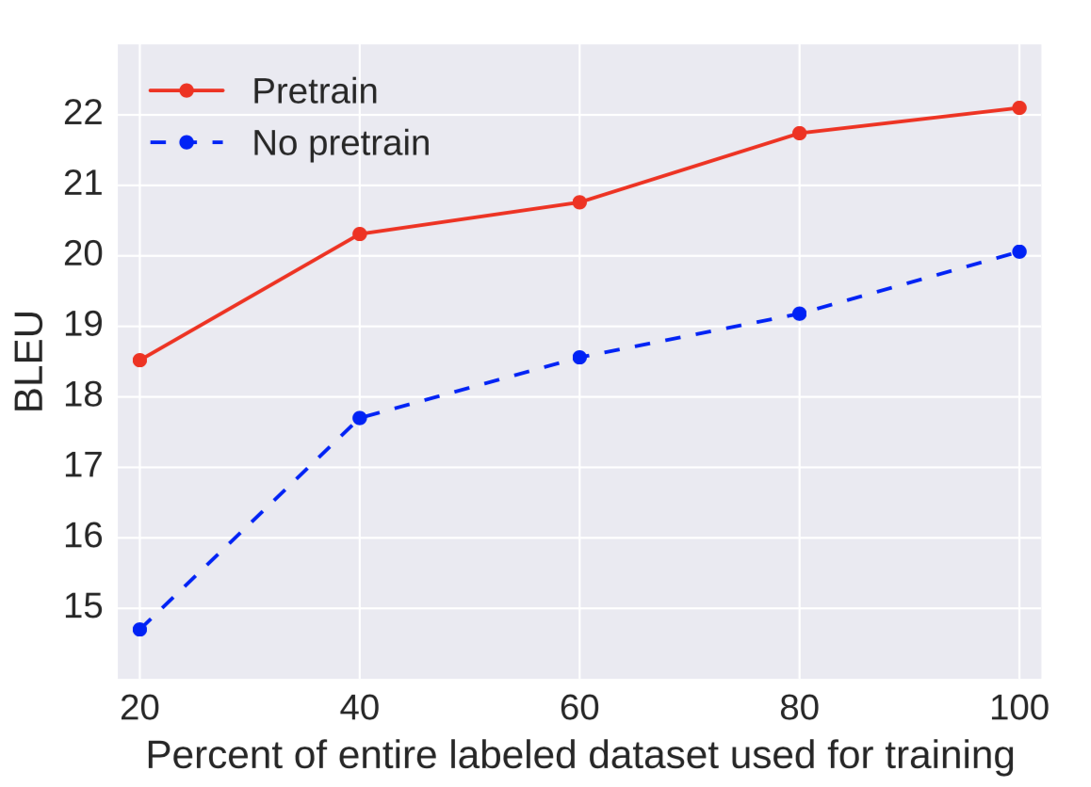
Ablation
Image: Fig.4, Unsupervised Pretraining for Sequence to Sequence Learning
Notes:
Validation performance of pretraining vs. no pretraining when trained on a subset of the entire labeled dataset for En-De translation
Both models use the additional LM objective
Observations:
When 100% of data is used, gap b/w pretrained and random model is 2.0 BLEU points
Gap grows when less data is available: with 20% of labeled data, gap is 3.8 BLEU points -> pretrained models degrade less as the labeled dataset becomes smaller

Slide 31
Paper 2 Discussion
Why do you think unsupervised pretraining with a language modeling objective improves performance on downstream tasks?
Can you think of any other language generation tasks that might benefit from similar pretraining?
Can you think of any other ways to avoid catastrophic forgetting?
Notes:
Catastrophic forgetting

Slide 32
Paper 3: Attention is All You Need
Ashish Vaswani, Noam Shazeer, Niki Parmar Jakob Uszkoreit, Llion Jones, Aidan N. Gomez, Lukasz Kaiser, Illia Polosukhin, NIPS 2017
Goal: propose new model for sequence transduction based solely on attention mechanisms - no more recurrence or convolutions!

Slide 33
Problems with RNNs
RNNs factor computation along the symbol positions of input and output sequences
Inherently sequential nature precludes parallelization within training examples
Improvements in computational efficiency with RNNs
Factorization tricks
Conditional computation
But… fundamental constraint of sequential computation remains
Solution to problem: self-attention!
Notes:
Conditional computation, where parts of the network are active on a per-example basis, has been proposed in theory as a way of dramatically increasing model capacity without a proportional increase in computation.

Slide 34
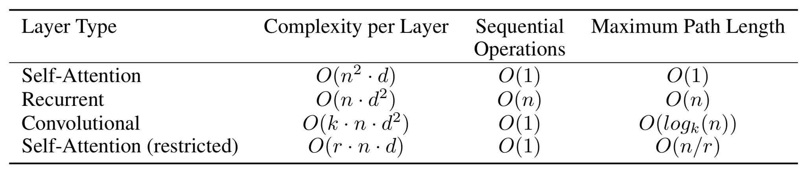
Why Self-Attention?
Three considerations:
Total computational complexity per layer
Amount of parallelizable computation
Path length between long-range dependencies in the network
Image: Table 1, Attention is All You Need
Notes:
n is sequence length, d is the representation dimension, k is the kernel size of convolutions, and r is the size of the neighborhood in restricted self-attention
Path length: path length in the network for calculating the interaction between two words
Total computational complexity per layer - for self-attention, complexity scales quadratically with the length of the input n (because must relate every token to every other token) but linearly with the representation dimensionality d. For RNNs, complexity instead scales linearly with the length of the input but quadratically with the representation dimensionality.
Therefore, self-attention layers are faster than recurrent layers when the sequence length n is smaller than the representation dimensionality, which is most often the case with sentence representations used by SOTA models in NMT, such as word-piece and byte-pair representations
To improve computational performance for very long sequences, self-attention could be restricted to considering only a neighborhood of size r in the input sequence centered around the respective output position. Would increase the maximum path length to O(n/r)
Amount of computation that can be parallelized, as measured by the minimum number of sequential operations required
Path length between long-range dependencies in the network
Learning long-range dependencies is a key challenge in sequence transduction tasks
Key factor affecting ability: length of paths forward and backward signals have to traverse in the network.
Shorter these paths between any combination of positions in the input and output sequences, easier to learn long-range dependencies
Recent work has shown RNNs have trouble learning long-range dependencies even though they have theoretically infinite memory - http://www.offconvex.org/2018/07/27/approximating-recurrent/

Slide 35
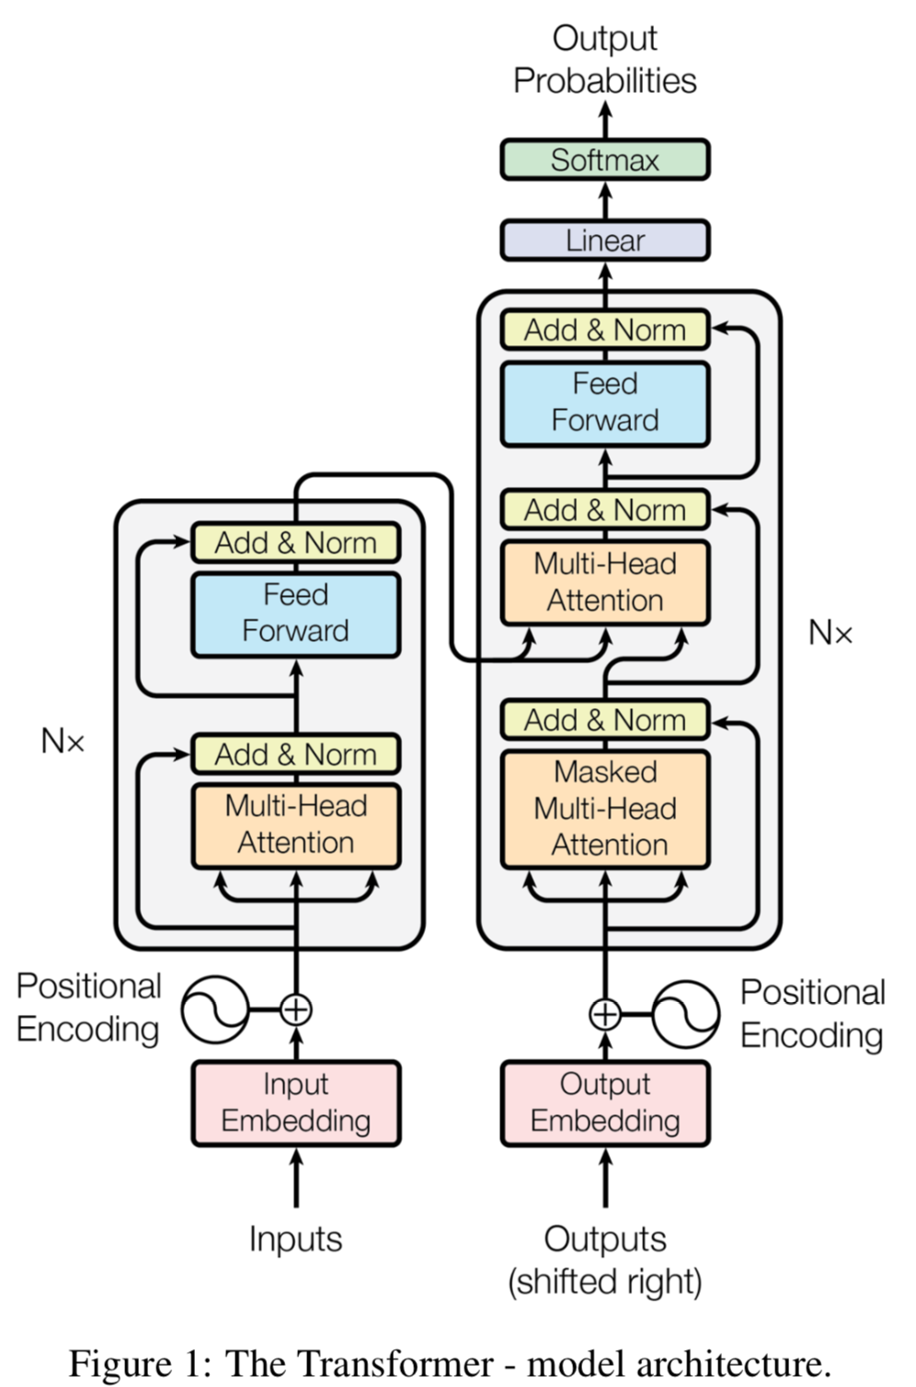
Transformer Model Architecture
Encoder: N identical layers (here N=6), each with two sub-layers
Multi-head self-attention mechanism
Simple, position-wise fully connected feed-forward network
Decoder: Also N identical layers
Same two sub-layers as in encoder
Adds third sub-layer: multi-head attention over the output of the encoder stack
Image: Fig.1, Attention is All You Need
Notes:
Transformer follows encoder-decoder architecture using stacked self-attention and point-wise, fully connected layers for both the encoder and decoder.
Encoder: Composed of N identical layers (here N=6). Each layer has two sub-layers:
Multi-head self-attention mechanism
Simple, position-wise fully connected feed-forward network
Decoder: adds third to attend over encoder outputs
Modify self-attention sublayer in the decoder stack to prevent positions from attending to subsequent positions (more later)

Slide 36
Add & Norm
Output of each sublayer:
LayerNorm(x + Sublayer(x))
where Sublayer(x) is the function implemented by the sub-layer itself.
Note: in some implementations (including Google’s own Tensor2Tensor implementation), this is actually computed as x + LayerNorm(Sublayer(x))
Notes:
Residual connection used around each of the two sublayers, followed by layer normalization.

Slide 37
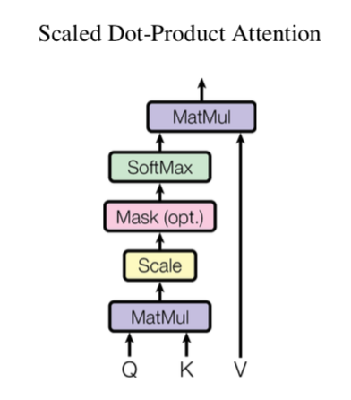
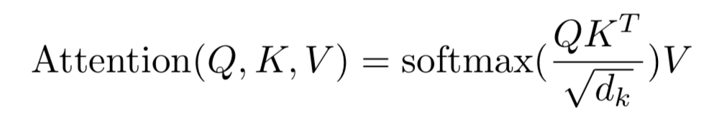
Attention
Attention function: maps a query and a set of key-value pairs to an output
Query, keys, values, and output all vectors
Output is computed as a weighted sum of the values, where the weight assigned to each value is computed by a compatibility function of the query with the corresponding key
Scaled Dot-Product Attention:
Image: Eq. 1, Attention is All You Need
Image: Fig. 2, Attention is All You Need
Notes:
softmax() is “weight” assigned to each value
The particular attention function proposed by the paper is scaled dot-product attention.
-Input consists of queries and keys of dimension d_k, and values of dimension d_v
-compute dot products of the query with all the keys, divide each by sqrt(d_k), and apply a softmax function to obtain the weights on the values
In practice, attention function is computed on a set of queries simultaneously packed together into a matrix Q. the keys and values are packed into matrices K and V. we comptute the matrix of outputs as Attention(Q,K,V)=...
Two most commonly used attention functions: additive attention, dot-product (multiplicative) attention.
Dot-product attention is same as our function without scaling factor of 1/sqrt(d_k)
Additive attention computes the compatibility function using a FFN with a single hidden layer.
While the two are similar in theoretical complexity, dot-product attn is much faster and more space-efficient in practice, b/c highly optimized matrix multiplication code can be used
While for small values of d_k, the two fxns perform similarly, additive attn outperforms DP attn without scaling for larger values of d_k, so authors added the scaling factor for the dot products
-(suspect that for large values of d_k, the dot products grow large in magnitude, pushing softmax fxn into regions where it has extremely small gradients)

Slide 38
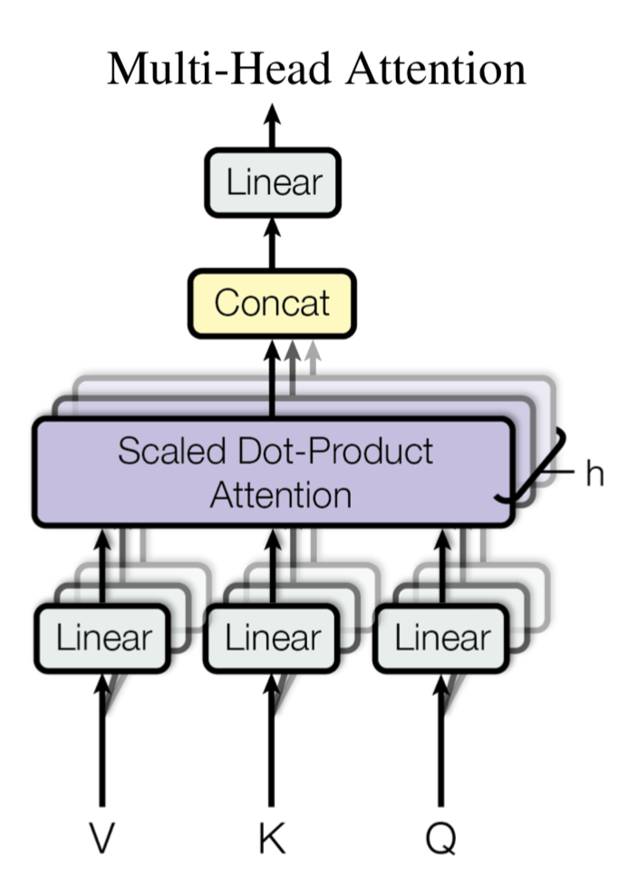
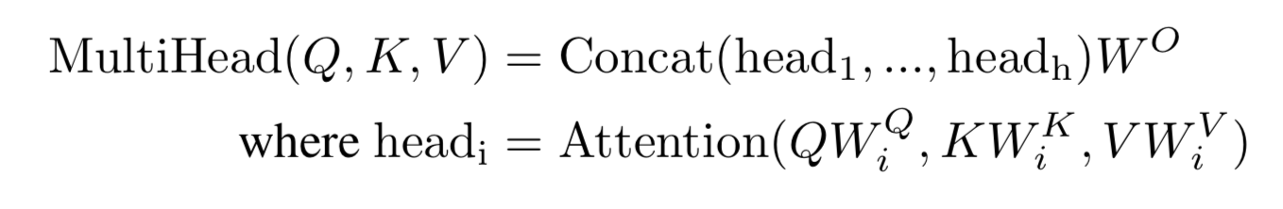
Multi-head Attention
Image: Fig. 2, Attention is All You Need
Image: Attention is All You Need
Notes:
Instead of performing a single attention function with keys, values, and queries of dimension d_model, authors found it beneficial to linearly project the queries, keys, and values h times with different, learned linear projections to d_k, d_k, and d_v dimensions, respectively. As we will see, different heads seem to learn to perform different tasks.
Then, perform the attention function in parallel on each of these projected versions, concatenate the outputs and project them again
Due to the reduced dimensionality of each head, the total computation cost is similar to that of a single-head attention with full dimensionality

Slide 39
Attention in the Transformer
Image: Fig.1, Attention is All You Need
Notes:
Transformer uses multi-head attention in three different ways:
-”encoder-decoder attention” layers: queries come from the previous decoder layer, memory keys and values come from
(final) output of the encoder.
-this allows every position in the decoder to attend over all positions in the input sequence, mimics the typical encoder-decoder attention mechanisms in sequence-to-sequence models
-encoder contains self-attention layers. In a self-attention layer all of the keys, values, and queries come from the same place, in this case, the output of the previous layer in the encoder. Each position in the encoder can attend to all the positions in the previous layer of the encoder (similar to a bidirectional LSTM but strictly more powerful - not just a concatenation of forward and backward passes over the data)
-self-attention in the decoder (next slide)

Slide 40
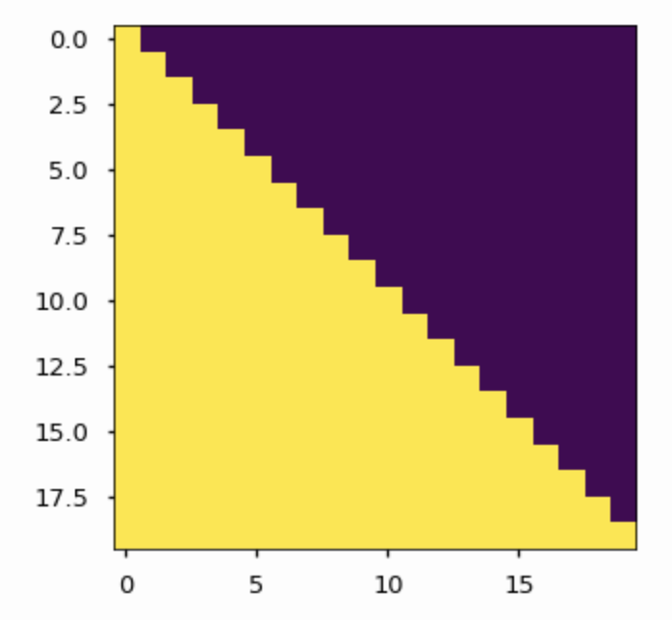
Masked Attention
Image: Fig. 2, Attention is All You Need
Image: The Annotated Transformer
Notes:
-self-attention layers in the decoder allow each position in the decoder to attend to all positions in the decoder UP TO AND INCLUDING THAT POSITION.
-Need to prevent leftward information flow in the decoder to preserve the auto-regressive property
-can’t let future information from the target sentence be used in determining what the next word in the output sentence should be
-ensures predictions for position i can depend only on the known outputs at positions less than i
-implement this inside of scaled dot-product attention by masking out (setting to -infty) all values in the input of the softmax which correspond to illegal connections (see Figure 2)

Slide 41
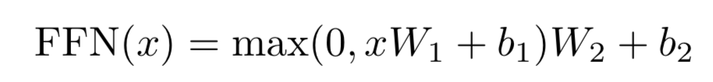
Position-wise Feed-Forward Networks
Image: Eq. 2, Attention is All You Need
Notes:
In addition to attention sub-layers, each of the layers in the encoder and decoder contains a fully connected feed-forward network, which is applied to each position separately and identically. This consists of two linear transformations with a ReLU activation in between
Note: the linear transformations are the same across different positions, but they use different parameters from layer to layer.
Another way of describing this as two convolutions with kernel size 1.

Slide 42
Embeddings and Softmax
Utilize learned embeddings to convert the input and output tokens to vectors of dimension d_model
Use typical learned linear transformation and softmax function to convert decoder output to predicted next-token probabilities
In this paper, same weight matrix is shared between two embedding layers and the pre-softmax linear transformation
In embedding layers, weights are multiplied by sqrt(d_model)

Slide 43
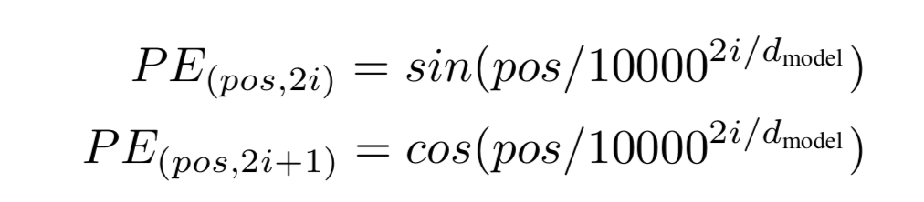
Positional Encoding
Must inject some information about position of the tokens of the sequence: positional encodings!
Image: Attention is All You Need
Notes:
Since Transformer contains no recurrence and no convolution, must inject some information about the relative or absolute position of the tokens in the sequence, in order for the model to make use of the order of the sequence.
Add “positional encodings” to the input embeddings at the bottoms of the encoder and decoder stacks. Have same dimension d_model as embeddings, so that the two can be summed.
Could use either learned or fixed positional embeddings. Here, they use sine and cosine functions of different frequencies (see equation).
where pos is the position and i is the dimension
The wavelengths form a geometric progression from 2pi to 10000*2pi
chosen because hypothesized it would allow the model to easily learn to attend by relative positions, since for any fixed offset k, PE_{pos+k} can be represented as a linear function of PE_pos
Also experimented with learned positional embeddings; found that two versions produced nearly identical results. Chose sinusoidal version because it might allow the model to extrapolate to sequence lengths longer than the ones encountered during training.
I have seen both used in the literature; something to experiment with if you use it yourself.

Slide 44

Visualization of Translation with Transformer
Image: Google Blog Transformer Post

Slide 45
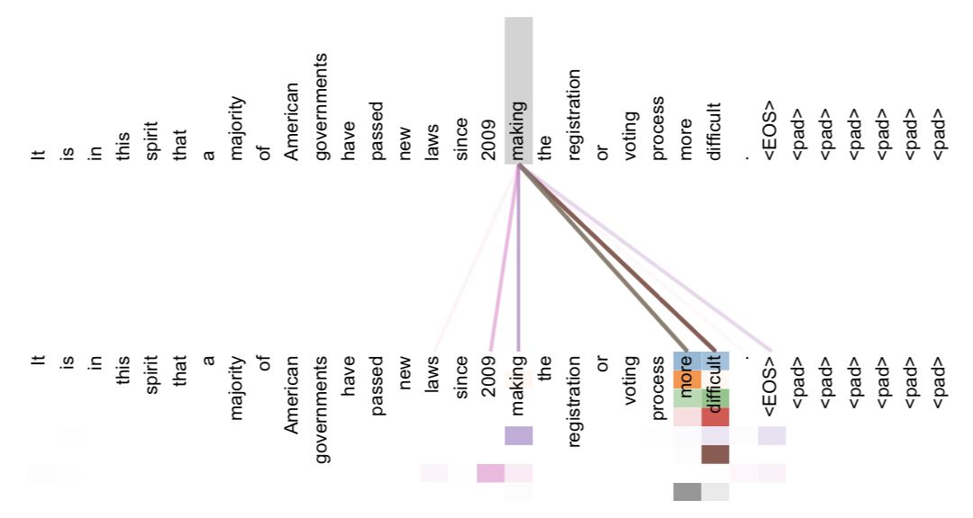
Attention Visualizations
Image: Fig. 3, Attention is All You Need
Notes:
Example of the attention mechanism following long-distance dependencies in the encoder self-attention in layer 5 of 6.
Many of the attention heads attend to a distant dependency of the verb ‘making’, completing the phrase ‘making...more difficult’.
Attentions here shown only for the word making. Different colors represent different heads.

Slide 46
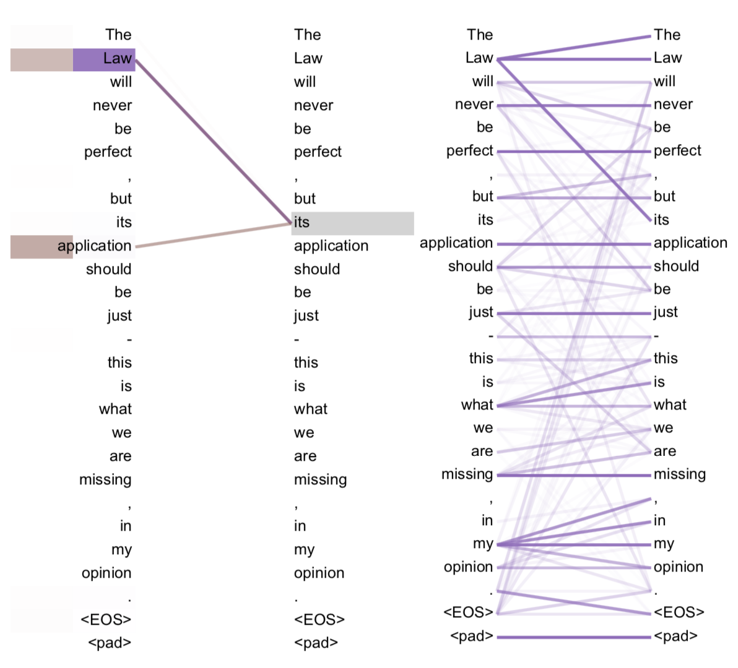
Attention Visualizations
Image: Fig. 4, Attention is All You Need
Notes:
Two attention heads, also in layer 5 of 6, apparently involved in anaphora resolution.
Right: Full attentions for head 5.
Left: Isolated attentions from just the word ‘its’ for attention heads 5 and 6. Note that the attentions are very sharp for this word.

Slide 47
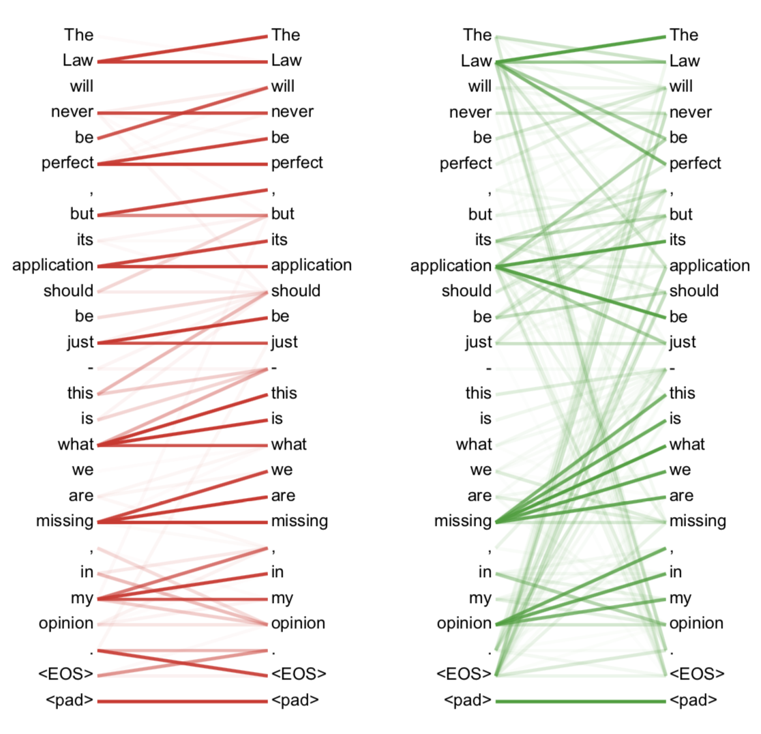
Attention Visualizations
Image: Fig. 5, Attention is All You Need
Notes:
Many of the attention heads exhibit behavior that seems related to the structure of the sentence.
Two examples: from two different heads from the encoder self-attention at layer 5 of 6. The heads clearly learned to perform different tasks.

Slide 48
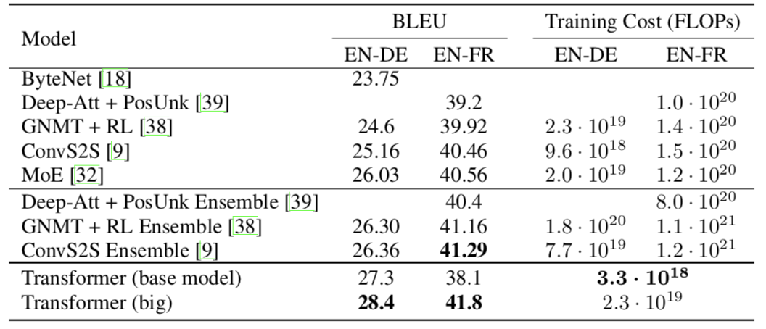
Results
Image:Table 2, Attention is All You Need
Notes:
Transformer (big) sets new SOTA on WMT 2014 for both English-to-German and English-to-French translation, surpassing even ensemble models with a single model, for a fraction of the training cost. Training took 3.5 days on 8 NVIDIA P100 GPUs.

Slide 49
Paper 3 Discussion
How important do you think the Transformer architecture will be moving forward? Could it replace RNNs entirely?
What novel aspect of the Transformer architecture did you find most compelling?
Can you think of any methods by which this SOTA-setting result might be improved?
Notes:
Future: unsupervised pretraining & finetuning with transformer encoder-decoder?

Slide 50
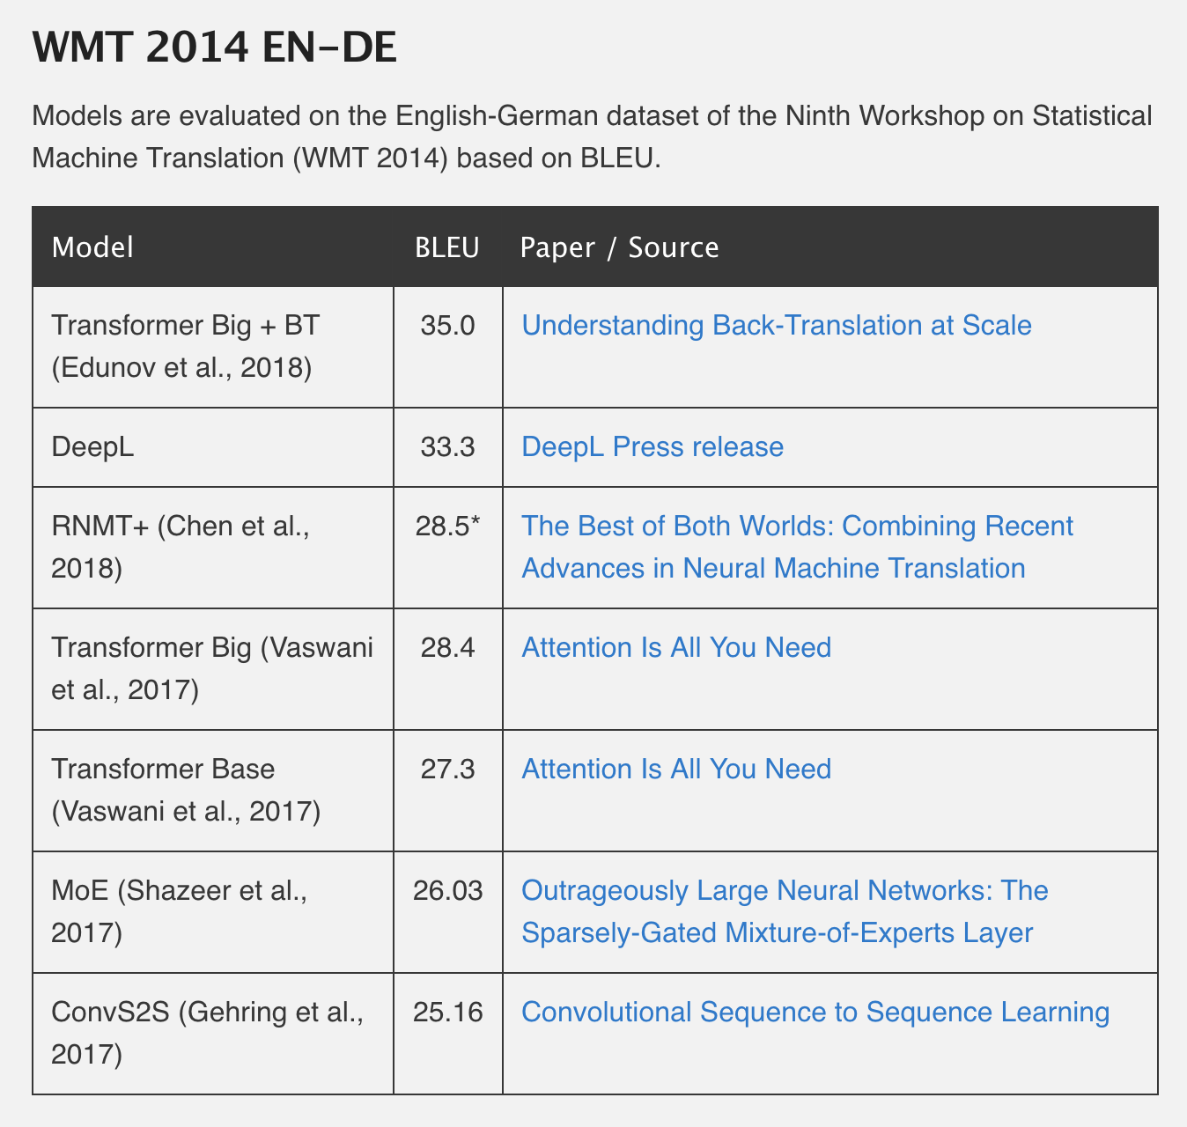
NMT: The Current Leaderboard (En-De)
Image: NLP Progress
Notes:
For reference, best ensemble of 5 from paper 2 scored 24.7, and that was only in early 2018… very rapid progress being made

Slide 51
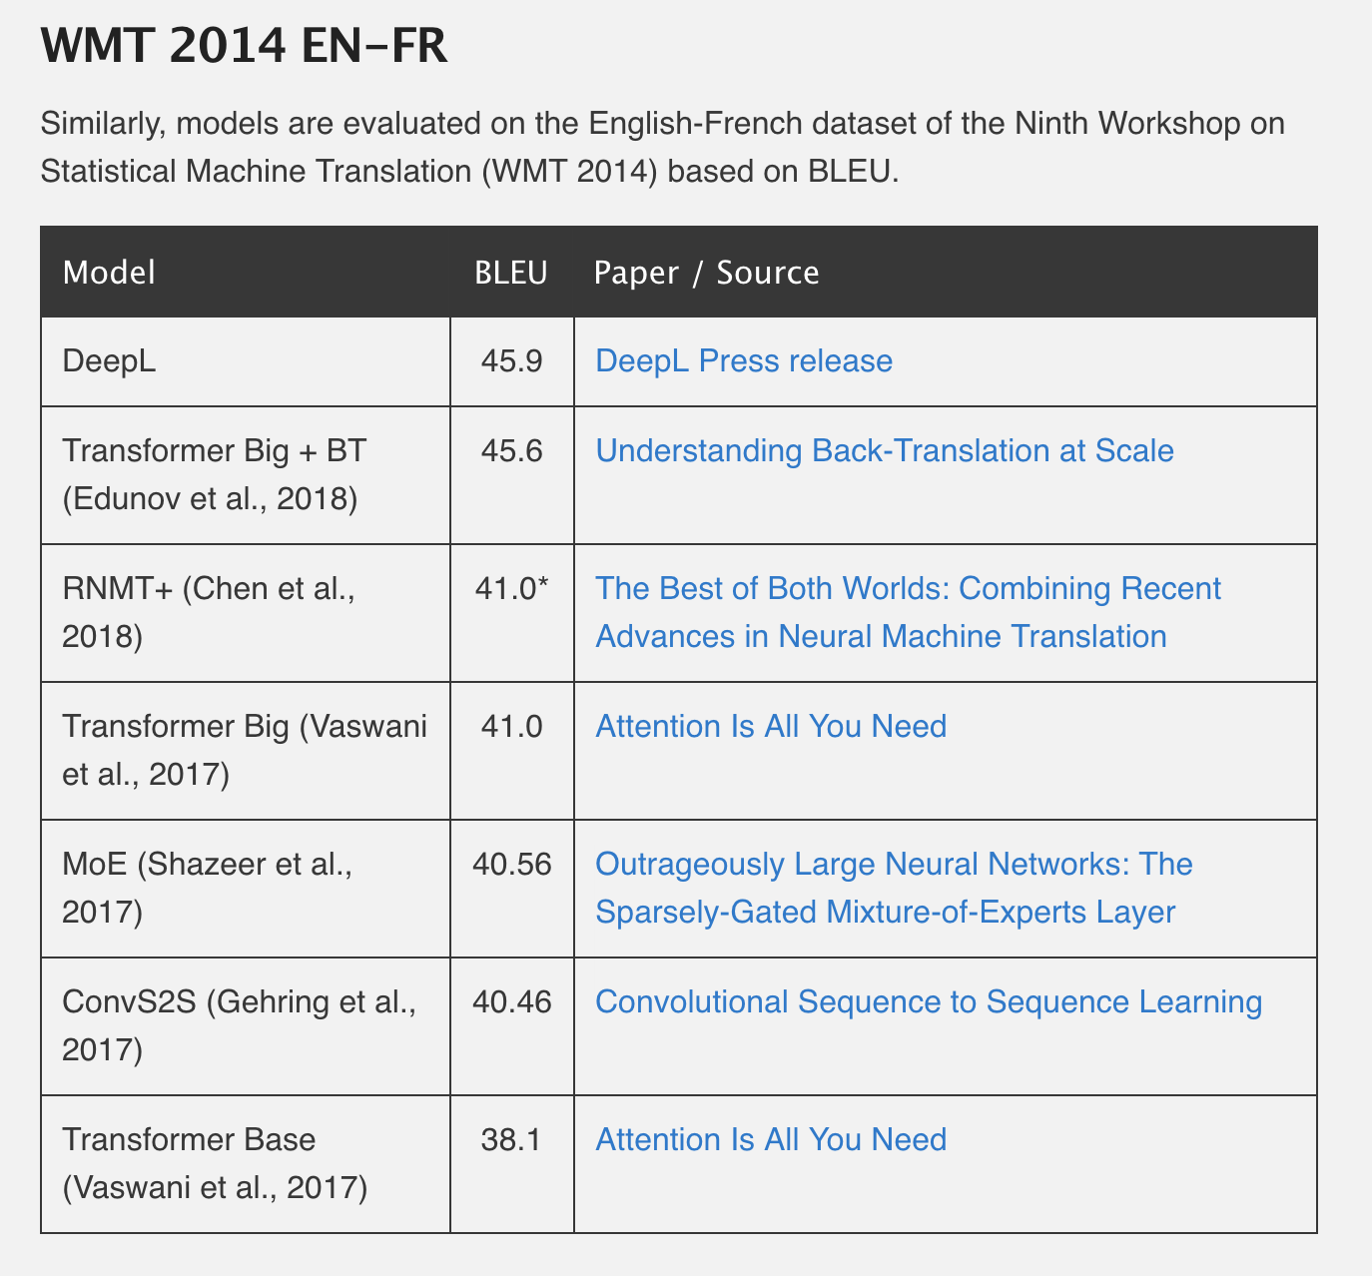
NMT: The Current Leaderboard (En-Fr)
Image: NLP Progress
Notes:
For reference, best ensemble of 5 models from paper 1 scored 34.81, 36.5 when used to rescore 1000-best list from SMT
Note: paper 1 noted that an oracle rescoring of the SMT baseline 1000-best lists resulted in a BLEU score of ~45. We are now matching, if not exceeding, that very, very strong baseline established 4 years ago.

Slide 52
Recent Advances & Improvements
RNMT+
Hybrid architecture combining strengths of both RNNs and Transformer
Scaling Neural Machine Translation (not shown on previous slides)
Same basic model as Paper 3, but new SOTA & fastest training times (with 128 GPUs):
En-De: 29.3 BLEU in 85 minutes
En-Fr: 43.2 BLEU in 8.5 hours
Transformer + back-translation
Augment parallel training corpus with back-translations of target language sentences
Note: back-translation with RNNs was the old SOTA surpassed by Paper 2

Slide 53
Fin
Thank you!

